Slide 1
MGMT-6064 PROJECT LEADERSHIP AND MANAGEMENT
Module 9: Acquiring, Developing, Managing Teams (PMBOK)

Slide 2
Topics
The Project Office
PMBOK: Acquire Resources (9.3)
PMBOK: Develop Team (9.4)
PMBOK: Manage Team (9.5)
Performance appraisals & giving feedback
Notes:
Source of material for slides: PMBOK 6e

Slide 3
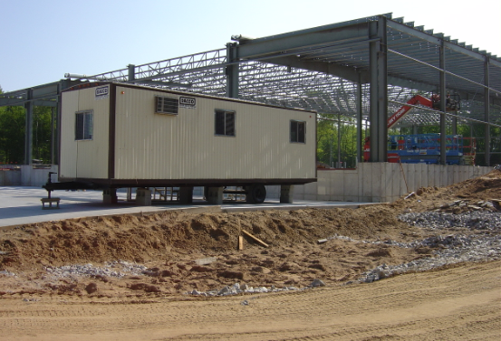
Project office (PO) (Kerzner)
Consists of administrative support for the Project Manager during the project
PO personnel are embedded/attached full time on the project team, or they may be a functional interface with the project
PO activities include communication, reporting, procurement, monitoring/controlling, contract management, cost management
A PO is usually different from a Project Management Office (PMO)
A PMO typically co-ordinates and supports portfolios, programs, and/or multiple projects; PMO also does strategic planning such as project selection
Notes:
Image: http://www.ipmglobal.net/img/ipm-guys-gears-resource-mgmt.jpg

Slide 4
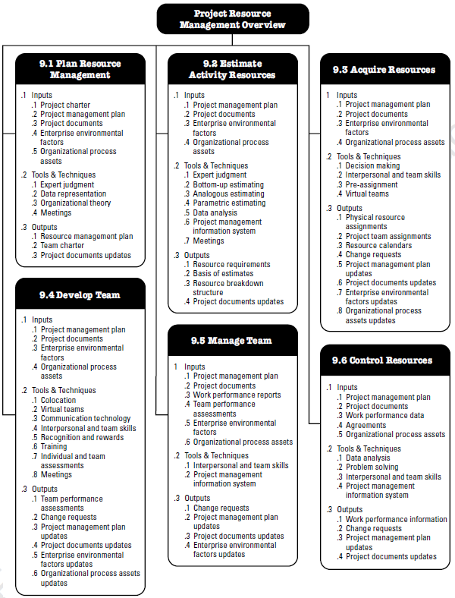
Project resource management Knowledge area
Plan Resource Management*
Estimate Activity Resources*
Acquire Resources*
Develop Team
Manage Team
Control Resources*
* Applies to all project resources (e.g., equipment), not just human resources!
Notes:
Source: PMBOK 6e, p. 308
Note: In previous versions of PMBOK, human resource management was a specific knowledge area (not combined with other resource management)

Slide 5

PMBOK 9.3 – Acquire resources
The process of obtaining various resources required to complete project work
Resources may be internally or externally sourced
Performed periodically throughout project as needed
Human resources include technical team members and functional team members (the ‘project office’)
Notes:
Image: http://www.ipmglobal.net/img/ipm-guys-gears-resource-mgmt.jpg

Slide 6

Acquire resources (inputs)
Project management plan
Project documents: e.g., schedule, stakeholder register, resource calendars
Enterprise environmental factors: e.g., availability, skill levels, salaries of potential project team members, organizational structures, geographic locations of resources
Organizational process assets: policies for acquiring or assigning resources, lessons learned from previous projects
(Note: Blue text in this slideshow – when studying Inputs/Tools & Techniques/Outputs, focus on the blue text rather than trying to memorize each specific ITTO)
Notes:
Image: https://thumbs.dreamstime.com/z/input-process-output-26459409.jpg

Slide 7
Acquire resources (Tools & Techniques)
Decision making: criteria include experience, ability, cost, attitude, location
Interpersonal and team skills: e.g., negotiation with functional managers, other project managers, external organizations/suppliers
Pre-assignment: some team members may have already been pre-identified to be on the team – e.g., they are named as key resources in the Project Charter
Virtual teams: can help reduce project costs, can widen the supply pool for team members based on geography or lack of mobility
Notes:
Image: https://thumbs.dreamstime.com/z/input-process-output-26459409.jpg

Slide 8
Acquire resources (outputs)
Physical resource assignments: for physical material
Project team assignments: team roles and responsibilities
Resource calendars
Change requests
Project management plan updates: e.g., cost baseline
Project document updates: e.g., resource breakdown structure, project schedule, project org chart
Enterprise environmental factors updates: e.g., availability of internal resource changes
Organizational process assets updates: e.g., internal documentation related to assigning resources
Notes:
Image: https://thumbs.dreamstime.com/z/input-process-output-26459409.jpg

Slide 9
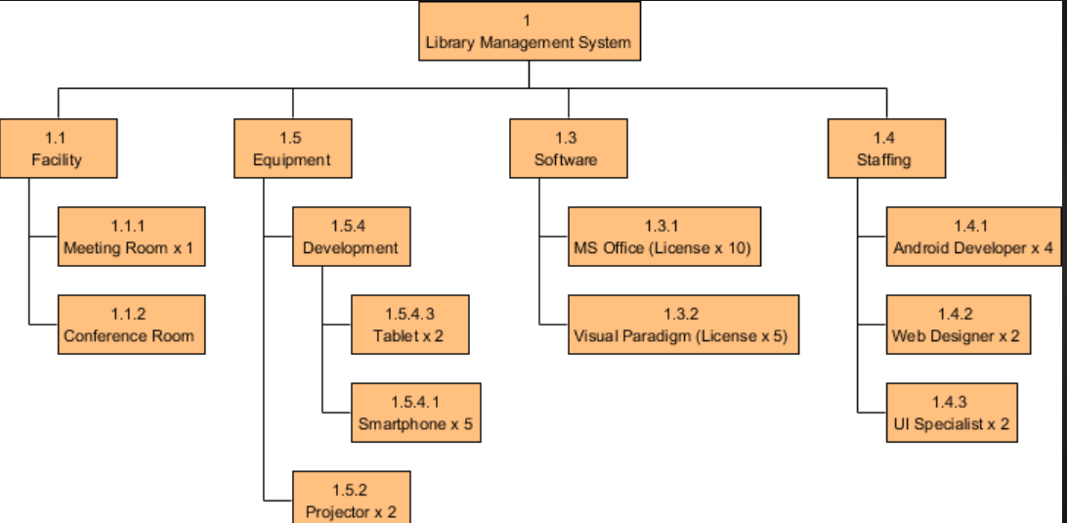
Example of Resource breakdown structure
Notes:
Sources:
https://cdn.visual-paradigm.com/tour/breakdown-structure-for-project-management/05-resource-breakdown-structure-example.png

Slide 10

PMBOK 9.4 – Develop team
Improving competencies and team effectiveness
Benefits: increases team cohesion, improves interpersonal skills, increases motivation, reduces attrition, improves project outcomes
Undertaken throughout project
(Video)
Notes:
Image: http://thecontextofthings.com/wp-content/uploads/2016/06/team-development.jpg

Slide 11
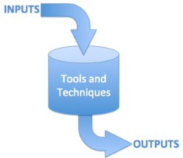
Develop team - Inputs
Project management plan
Project documents: e.g., project schedule, resource calendars, team charter
Team charter: contains team operating guidelines, values, expectations, structure, etc.
Enterprise environmental factors: e.g., policies regarding employee discipline and rewards, team member skills, geographic location of team members
Organizational process assets: e.g., lessons learned from past projects
Notes:
Image: https://oppmi.com/myoppm/_js/tinymce/jscripts/tiny_mce/plugins/advimage/_js/ImageManager/UserImages/Inputs_Outputs.png

Slide 12
Develop team – Tools & techniques
Colocation
Virtual teams
Communication technology: e.g., email, video conferencing, project internal website
Interpersonal and team skills: e.g., conflict management, negotiation, team building
Recognition and rewards: be mindful of cultural considerations, rewards may be tangible or intangible (meeting extrinsic or intrinsic needs)
Notes:
Image: https://oppmi.com/myoppm/_js/tinymce/jscripts/tiny_mce/plugins/advimage/_js/ImageManager/UserImages/Inputs_Outputs.png

Slide 13
Develop team – Tools & techniques (cont’d)
Training: formal or informal, technical or soft skills, costs may (or may not) be incorporated into budget, in-house or external trainers
Individual and team assessments: assess team members preferences, decision-making, interaction styles
Meetings: kick-off, team-building, team development
Notes:
Image: https://oppmi.com/myoppm/_js/tinymce/jscripts/tiny_mce/plugins/advimage/_js/ImageManager/UserImages/Inputs_Outputs.png

Slide 14
Develop team - outputs
Team performance assessments: e.g., completed performance feedback forms that lists skill gaps or recommended training
Change requests
Project management plan updates
Project documents updates: e.g., project team assignments
Enterprise environmental factor updates: e.g., employee development plan records
Organizational process asset updates: e.g., assessment forms
Notes:
Image: https://oppmi.com/myoppm/_js/tinymce/jscripts/tiny_mce/plugins/advimage/_js/ImageManager/UserImages/Inputs_Outputs.png

Slide 15

PMBOK 9.5 – manage team
Tracking team member performance, providing feedback, resolving issues, managing changes to team
Requires interpersonal skills such as:
Communication
Conflict management
Negotiation
Leadership
(Video)
Notes:
Image: http://study-aids.co.uk/dissertation-blog/wp-content/uploads/2014/12/Managing-Team-Performance.jpg

Slide 16

Manage team - Inputs
Project management plan
Project documents: e.g., issue log, team assignments
Work performance reports: e.g. schedule control reports to assist in determining rewards
Team performance assessments: formal or informal performance appraisals
Enterprise environmental factors: e.g., human resource management policies
Organizational process assets: e.g., organizational rewards like certificates of appreciation
Notes:
Image: http://www.bibleandbusiness.com/wp-content/uploads/2014/02/Input-Output.jpg

Slide 17
Manage team – tools & techniques
Interpersonal and team skills:
Decision making
Emotional intelligence: ability to identify, assess, and manage your emotions and the emotions of others
Conflict management: appropriate strategy depends on…
Importance/intensity of conflict
Time pressure to resolve conflict
Relative power of people involved in conflict
Importance of maintaining good relationship
Motivation to resolve conflict on long- or short-term basis
Notes:
http://www.bibleandbusiness.com/wp-content/uploads/2014/02/Input-Output.jpg

Slide 18
Manage teams – tools & techniques (cont’d)
Interpersonal skills (cont’d):
Influencing, which includes skills such as…
Persuading
Articulating your position/ opinion
Active listening
Awareness of different perspectives
Gathering information while maintaining trust
Leadership: ability to lead and inspire others
Project management information system (PMIS): e.g., MS Project
Notes:
http://www.bibleandbusiness.com/wp-content/uploads/2014/02/Input-Output.jpg
For practical purposes, the difference between power and influence is this: power is more coercive, getting people to do something you want them to do. Influencing is being able to persuade people to voluntarily do what you want them to do. See previous course Module on Sources of Power. According to PMBOK’s list of types of power, influencing might be equivalent to ‘persuasive power’.

Slide 19
Manage team - Outputs
Change requests: e.g., outsourcing work because team member leaves
Project management plan updates: e.g., schedule baseline updates
Project document updates: e.g., issue log updated, project team assignments updated
Enterprise environmental factors updates: e.g., organizational performance appraisal records updated
(NO Organizational process assets updates)
Notes:
http://www.bibleandbusiness.com/wp-content/uploads/2014/02/Input-Output.jpg

Slide 20
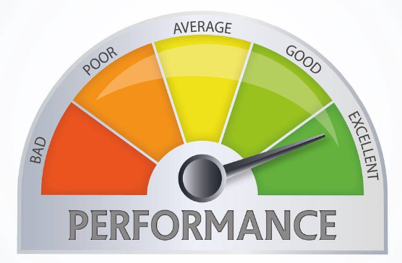
General Tips for performance management
Explain expectations
Monitor performance
Give opportunities to improve performance
Document, document, document
Use metrics where possible
Consider peer or ‘360 degree’ evaluations
Consult with HR department (for techniques, disciplinary procedures, legal constraints, etc.)
Notes:
Image: https://miro.medium.com/max/1200/1*FhpnyHS2oSfqijAz0jR4Lg.jpeg

Slide 21
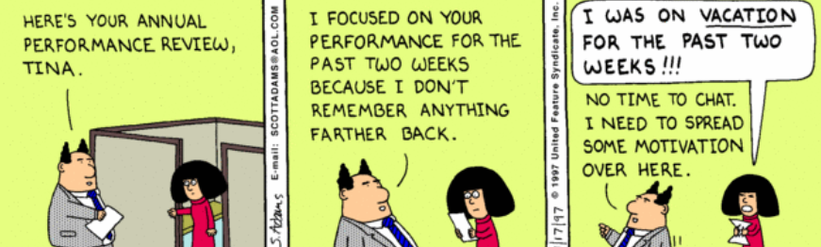
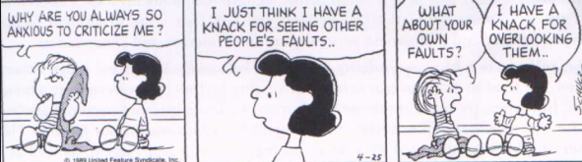
Tips for performance appraisals: avoid biases!
PRIMACY EFFECT | An opinion (good or bad) is formed early and it influences later perceptions of performance
RECENCY EFFECT | Evaluation is skewed to the most recent performance of the team member
LENIENCY/ HARSHNESS BIAS | Consistently rating all team members higher/lower than deserved
FUNDAMENTAL ATTRIBUTION EROR | Attributing performance to situational factors if you like the team member, while attributing performance to personal factors (e.g., laziness) if you dislike the team member
Notes:
Image: http://www.monarconsulting.com/consulting/wp-content/uploads/2012/01/Dilbert_PerformanceReview1.gif
Information: https://d2mxuefqeaa7sj.cloudfront.net/s_4BBEB6923A91B7D47F03122F0190AEC45D8C9D9031C4E9BEEE203B97EBC19AA0_1517667794091_Screen+Shot+2018-01-29+at+4.27.39+PM.png
Peanuts Cartoon: https://www.google.com/url?sa=i&rct=j&q=&esrc=s&source=images&cd=&cad=rja&uact=8&ved=2ahUKEwj30YP_yuDeAhWHxIMKHYR4CksQjRx6BAgBEAU&url=https%3A%2F%2Fsites.google.com%2Fa%2Fsunsetparkhighschool.org%2Fpsychology%2Fsociocultural%2Factivity-fundamental-attribution-error&psig=AOvVaw0PJRvIuH4KL5K_5k0gx_4R&ust=1542721328345221

Slide 22
Tips for performance appraisals: avoid biases!
HALO EFFECT | Overall favourable evaluation based on only one or two positive aspects of performance
COMPARATIVE BIAS | Evaluating team members in comparison to each other instead of based on ability to meet clearly established performance expectations
AFFINITY/ ALIENATION BIAS | Rating the team member more positively if he/she has characteristics in common with you. Rating the team member less positively if he/she doesn’t have anything in common with you.
IDENTITY BIAS | Evaluating the team member differently (positively or negatively) based on stereotypes (religious, political affiliation, race, age, disability, gender, age, sexual orientation, etc.)
EXCEPTION BIAS | Evaluation is skewed to a handful of isolated events rather than ongoing/typical performance
Notes:
Information: https://d2mxuefqeaa7sj.cloudfront.net/s_4BBEB6923A91B7D47F03122F0190AEC45D8C9D9031C4E9BEEE203B97EBC19AA0_1517667794091_Screen+Shot+2018-01-29+at+4.27.39+PM.png

Slide 23
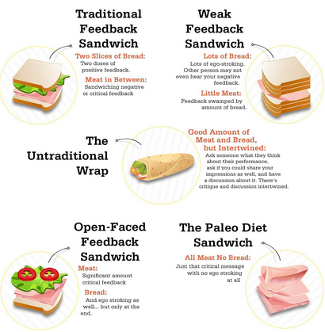
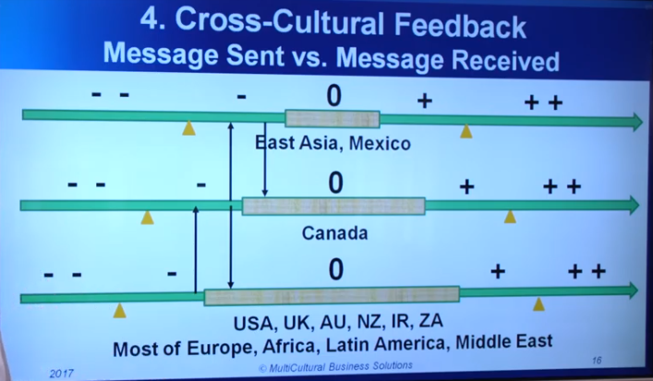
Feedback Patterns
Be mindful of cross-cultural patterns! (video)
Notes:
Sources:
Message Sent/Received: https://www.youtube.com/watch?v=qMtw2D6OOZ0
Feedback Sandwiches: https://cdn-images-1.medium.com/max/1600/0*WKJgcavaeu9SVxzY.jpg

Slide 24

Technique for giving feedback: ‘CEDAR’
C – Clarify the performance you expect to see
E – Explain the behaviour that you observed
D – Discuss the reasons for the differences in expected vs observed behaviour
A – Agree on steps to fix the problem
R – Review the outcomes (follow-up)
(video)
Notes:
Image: https://s3.amazonaws.com/media.eremedia.com/uploads/2016/11/03145703/Performance-review.jpg

